Slide 1
WQD7004
Programming for Data Science
Chapter 7
Data Preparation

Slide 2
Contents
Introduction
Data Cleaning
Data Transformation
Data Integration
Data Conversion

Slide 3
Introduction
Data Science is all about a systematic process used by data scientists to analyze, visualize and model large amounts of data.
A data science process helps data scientists use the tools to find unseen patterns, extract data, and convert information to something meaningful.
However, we always face data quality problems due to manual data entry errors, duplicate data, missing values, data transformation errors etc.
Data quality problems are expensive and pervasive. It can lead to inaccurate analysis and poor business decisions.

Slide 4
Introduction
There are errors in data collection
  Corrupt records
  Missing values
    NA, ""
  Structural errors
    Data type errors (integer become character)
    Columns swap position
    Currency format change (USD → RM)
  Duplicate records
  Unwanted outliers

Slide 5
Introduction
Data preparation is the process of cleaning, transforming, and reorganizing data so that it can be easily analyzed.
Some common tasks involved in data preparation:
  Importing data
  Data cleaning
  Data transformation
  Data integration
  Data conversion
Data preparation is an important step to ensure that the data is accurate, complete, and in the right format for analysis in R.

Slide 6
Data Cleaning
Data Cleaning is the process of identifying the incorrect, incomplete, inaccurate, irrelevant or missing part of the data and then modifying, replacing or deleting them according to the necessity.
80% of a typical data science project is sourcing cleaning and preparing the data, while the remaining 20% is actual data analysis.
Mostly has to be performed almost manually with the help of tools such as R.
Data cleaning is considered a foundational element of the basic data science. The package used for cleaning data includes dplyr, tidyr, lubridate and stringr.

Slide 7
Data Cleaning
complete.cases() returns a data frame with no missing values.
any(is.na(dataframe)) is used to check any NAs value in the dataframe.
nrow(na.omit(dataframe)) is used to count the total rows with no NA values in any column of data frame.
Exclude missing value from analyses
  mean(x, na.rm=TRUE)
sum() function can be used to display the total rows with empty value and which() functions can be used to return the row number with empty value.

Slide 8
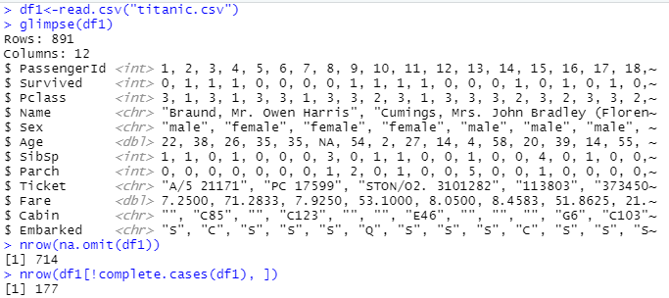

Data Cleaning
Exploring Raw Data

Slide 9
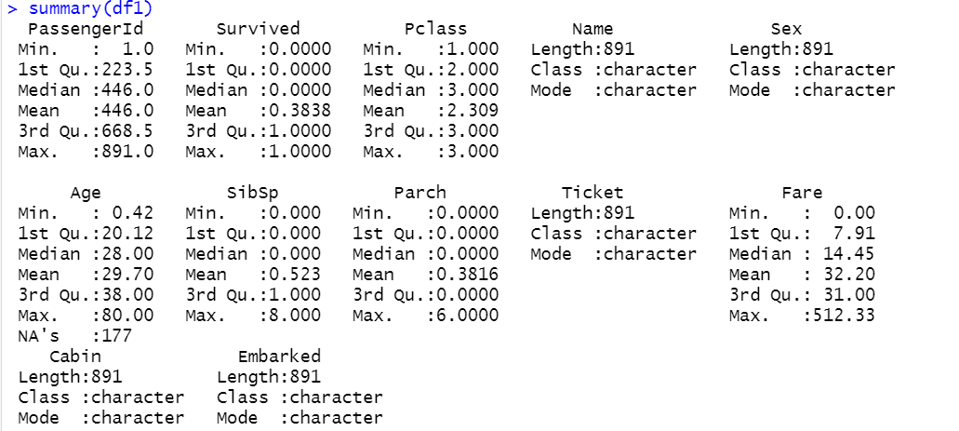
Data Cleaning

Slide 10
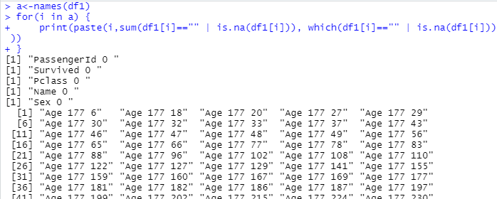
Data Cleaning

Slide 11
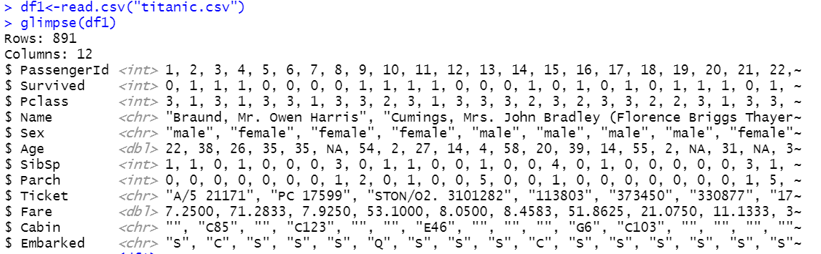
Data Cleaning
Replace all missing value, "" with NA.

Slide 12
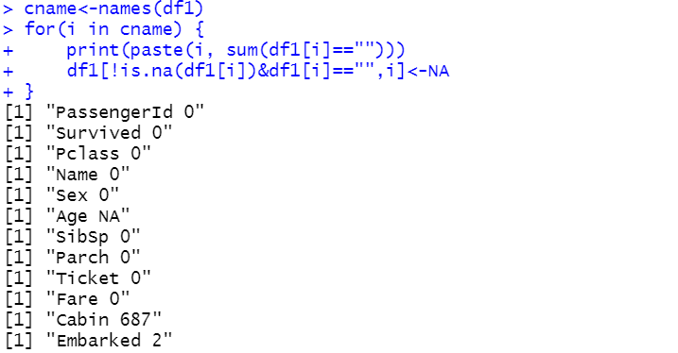
Data Cleaning

Slide 13
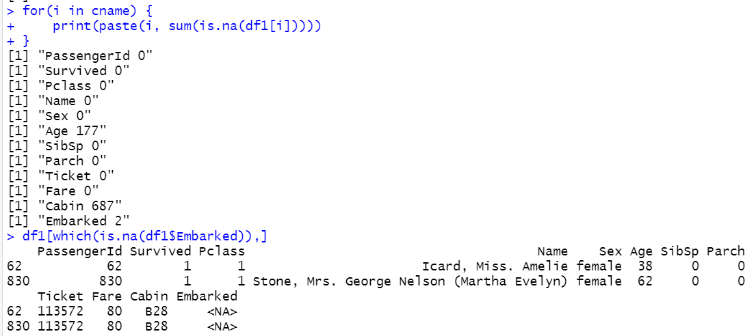
Data Cleaning

Slide 14
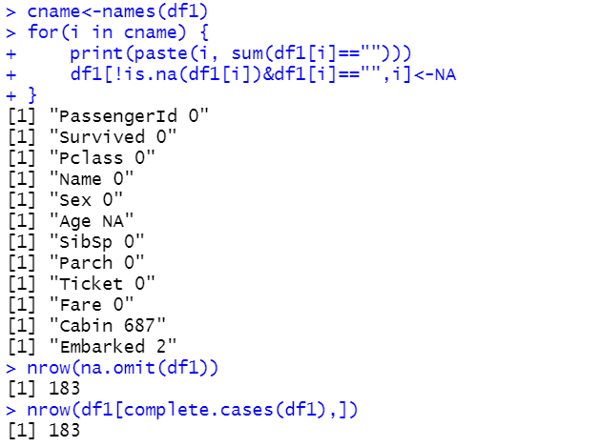
Data Cleaning
Before cleaning, the total rows with no NA values is 714. After cleaning, the total rows with no NA values is 183. This is due to a lot of missing value in Age and Cabin columns.

Slide 15
Data Transformation
Data Transformation
  The process of converting or modifying raw data into a suitable format or structure for analysis.
  It involves changing the original form of the data to make it more understandable, meaningful, or useful for specific analytical tasks.
  By transforming the data into a more suitable format, data scientists and analysts can more easily explore, understand, and draw insights from the data.

Slide 16
Data Transformation
Tidy data is data that’s easy to work with: it’s easy to manipulate (dplyr), visualise (ggplot2) and model.
The two most important properties of tidy data are:
  Each column is a variable
  Each row is an observation
tidyr is a package that reshapes the layout of the tables.
  install.packages("tidyverse")
  library(tidyverse)

Slide 17
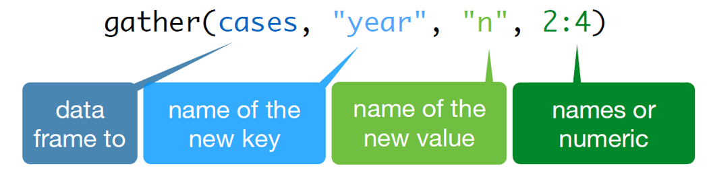
Data Transformation
gather() function
  It takes multiple columns and gathers them into key-value pairs, duplicating all other columns as needed.

Slide 18
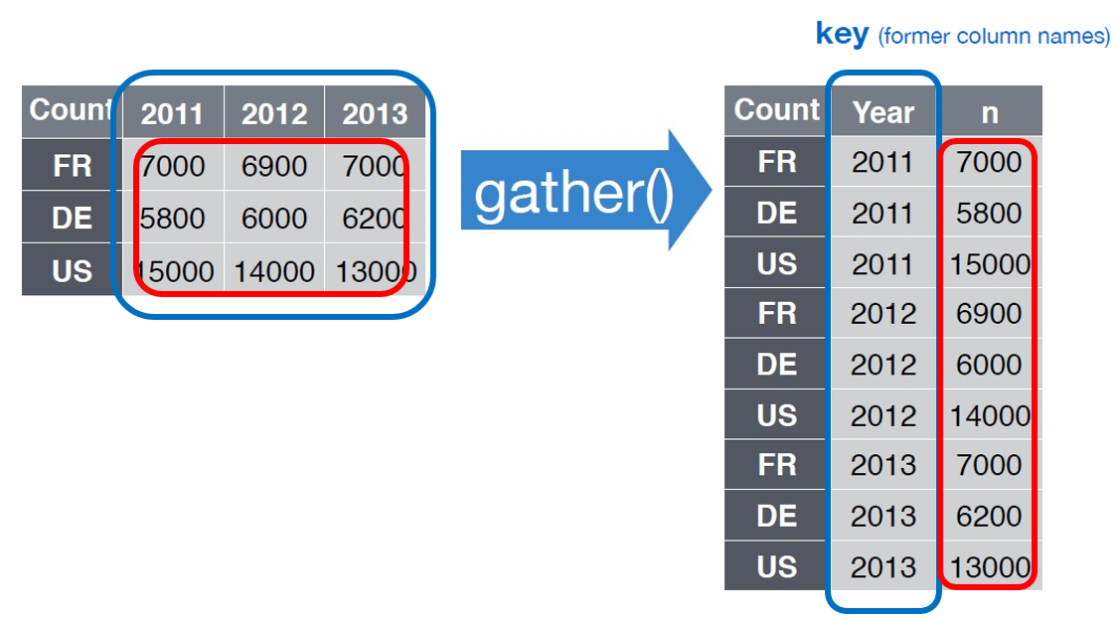
Data Transformation

Slide 19
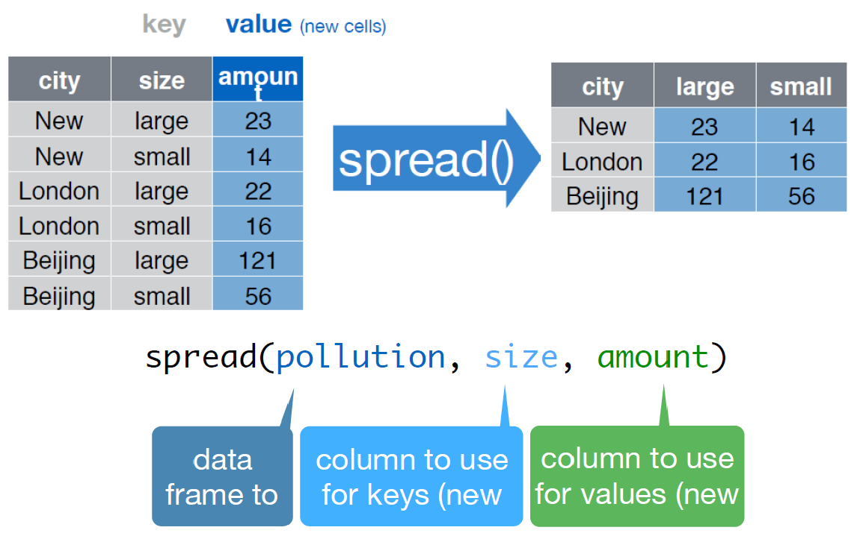
Data Transformation
spread() function
  It spreads a key-value pair across multiple columns

Slide 20
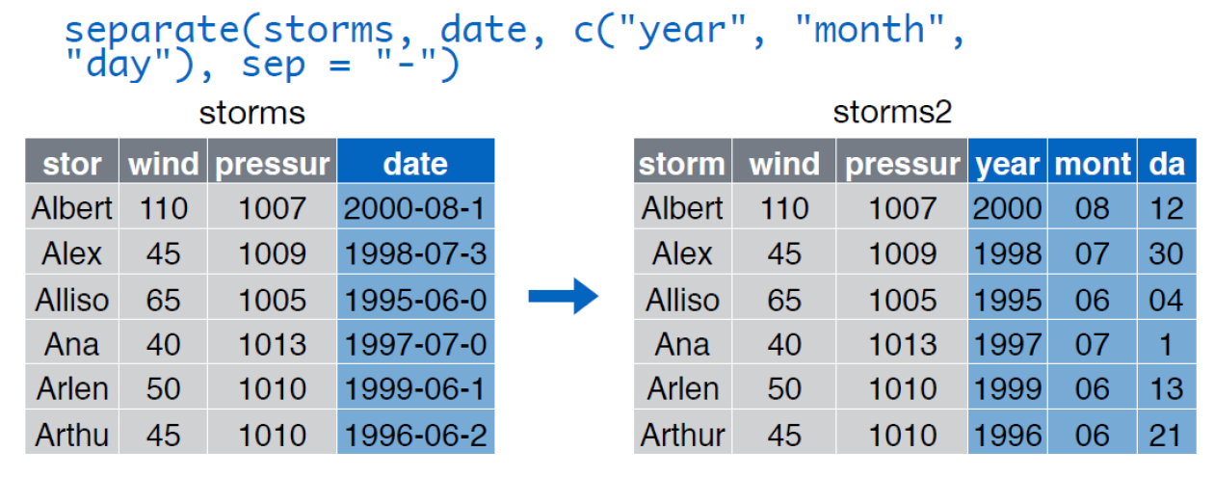
Data Transformation
separate() function
  Turns a single character column into multiple columns.

Slide 21
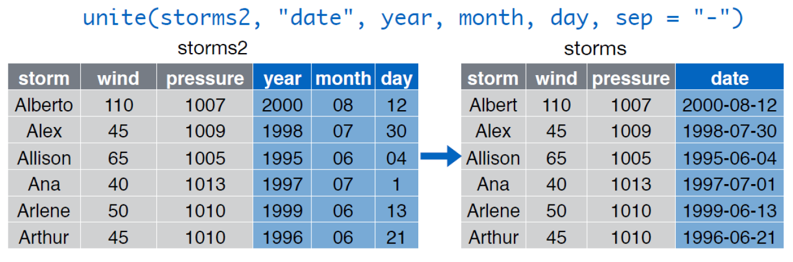
Data Transformation
unite() function
  It merges few columns into one column.
  It combines few variables of a single observation into one variable.

Slide 22
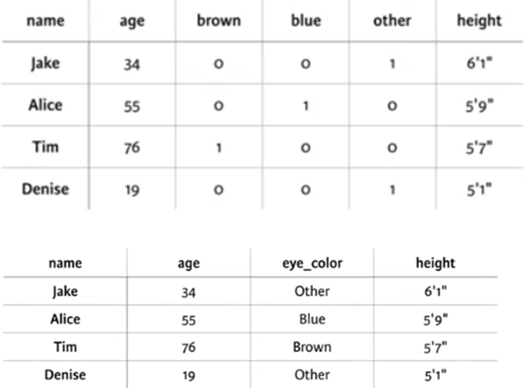
Data Transformation
Case Study 1

Slide 23
Data Transformation
Step 1 : Gather
  gather(df1, eye_color, color_value, 3:5)
Step 2 : Filter
  filter(df1, color_value==1)
Step 3 : Select
  select(df1, c("name", "age", "eye_color", "height"))
df1<-df1 %>% gather(eye_color, color_value, 3:5) %>% filter(color_value==1) %>% select(c("name", "age", "eye_color", "height"))

Slide 24
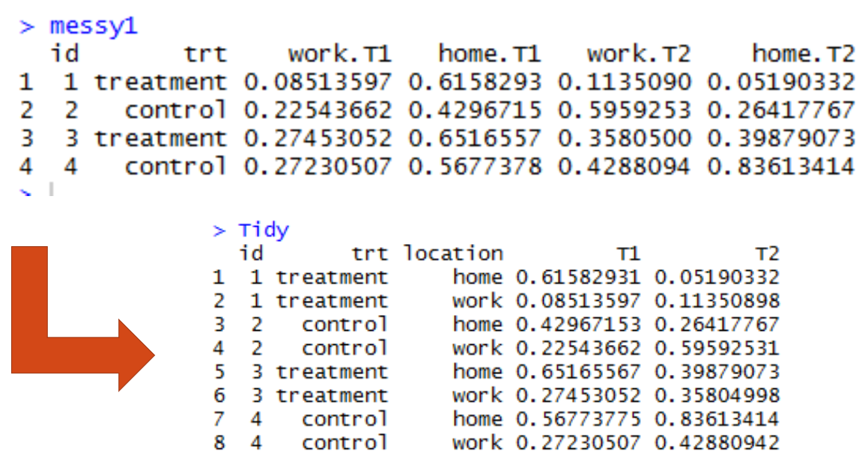
Data Transformation
Case Study 2

Slide 25
Data Transformation
Step 1 : Gather Key and Time
  gather(messy1, key, time, 3:6)
Step 2 : Separate key into two columns
  separate(messy1, key, c("Location", "Slot"), sep="\\.")
Step 3: Spread the Slot (value) into columns name
  spread(messy1, Slot, time)
tidy<-messy1 %>% gather(key, time, 3:6) %>% separate(key, c("Location", "Slot"), sep="\\.") %>% spread(Slot, time)

Slide 26
Data Integration
Data integration
  The process of combining data from multiple sources into a unified view, which can be used for analysis, reporting, or decision-making.
  The goal of data integration is to provide a complete and accurate picture of the data, by combining data from multiple sources into a single coherent structure.
  This can be done using techniques such as merging, joining, and concatenating data.

Slide 27
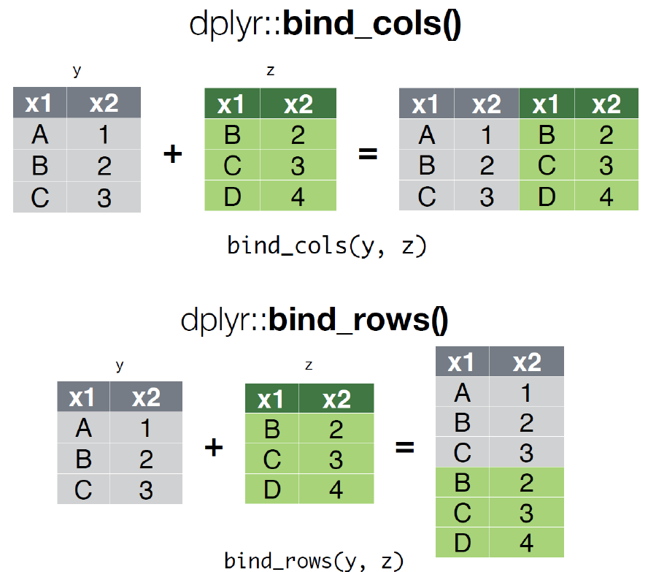
Data Integration

Slide 28
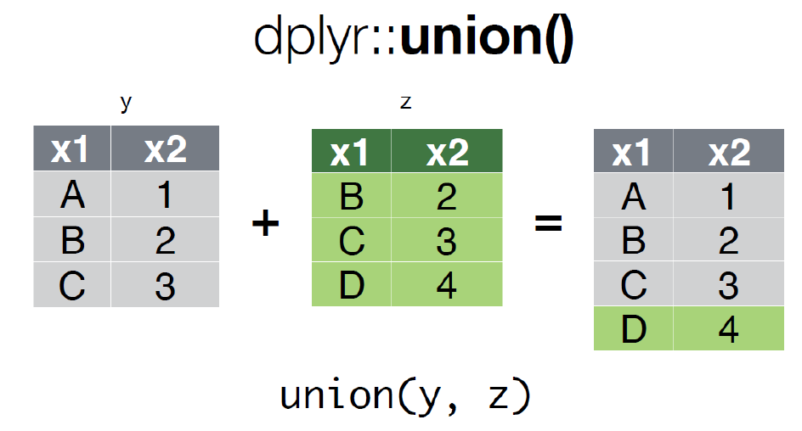
Data Integration

Slide 29
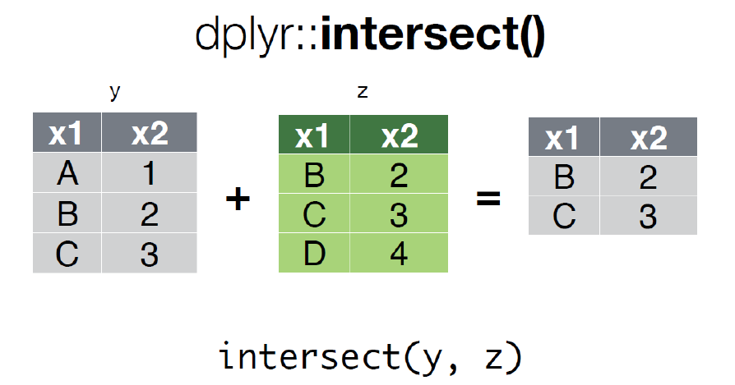
Data Integration

Slide 30
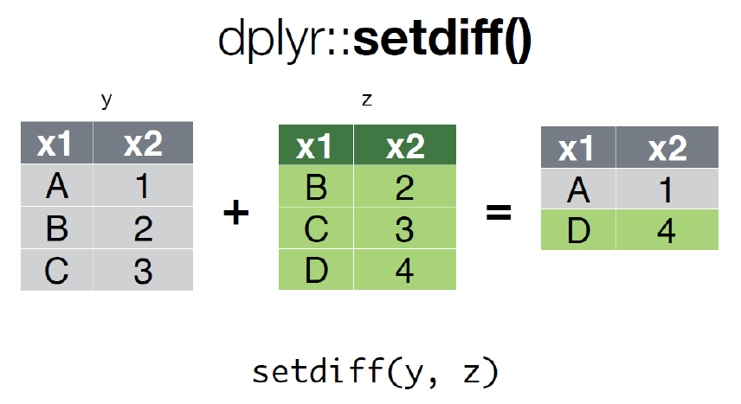
Data Integration

Slide 31
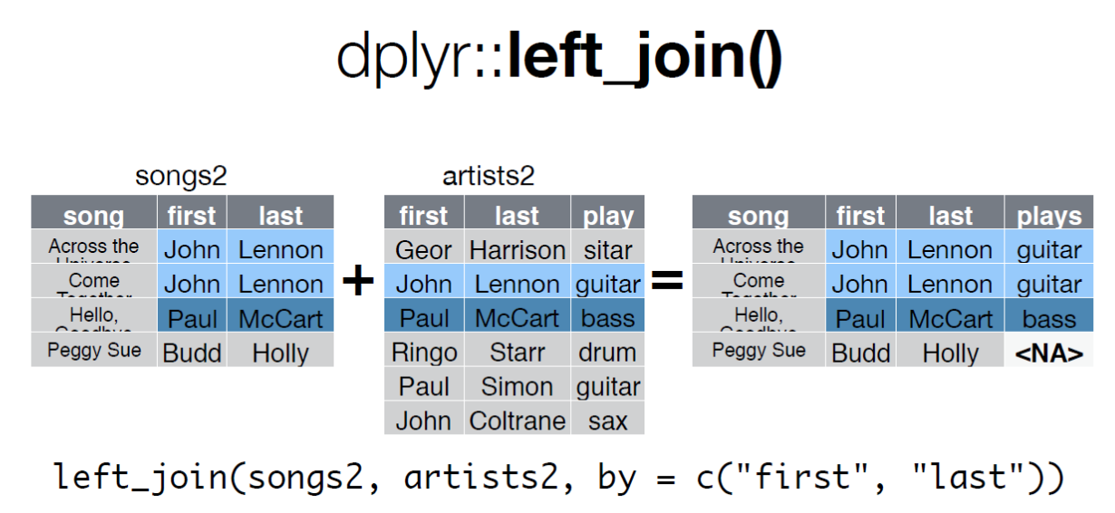
Data Integration

Slide 32
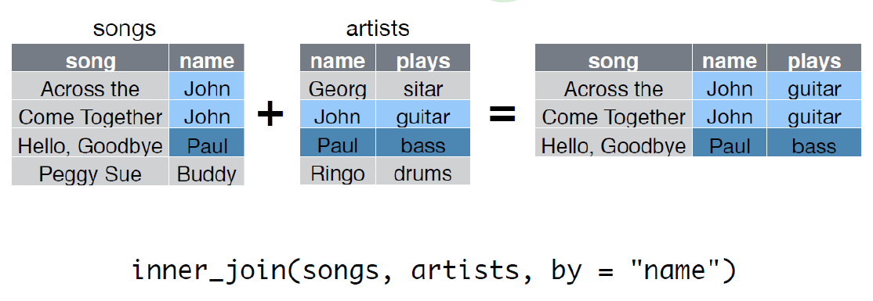
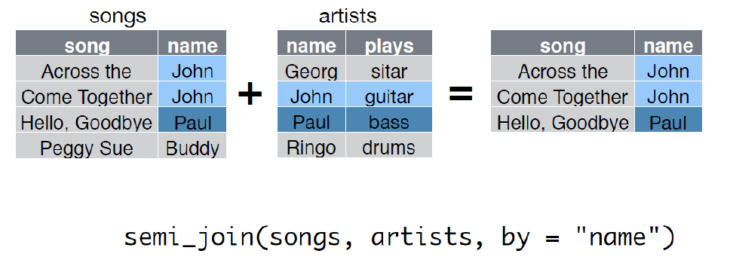
Data Integration

Slide 33
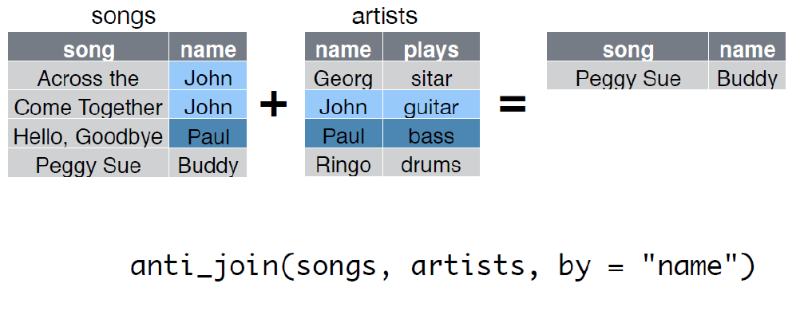
Data Integration

Slide 34
Data Conversion
Data conversion refers to the process of changing the format or structure of data from one type to another. This is an important step in data preparation because different analyses may require different data types or formats.
R commands for date-times are generally unintuitive and change depending on the type of date-time object being used.
Lubridate makes it easier with date-times.
  install.packages("lubridate")
  library(lubridate)
Common functions
  ymd(), ymd_hms(), dmy(), dmy_hms(), mdy()

Slide 35
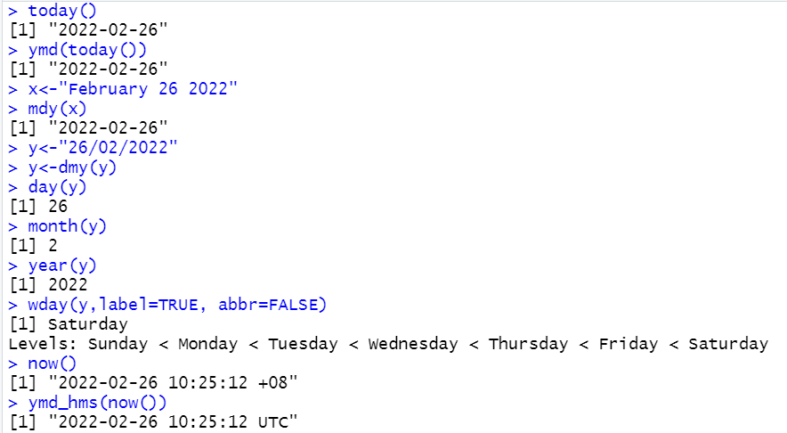
Data Conversion
today() and Sys.Date() function return today's date.
now() and Sys.time() function return current date and time.

Slide 36
Data Conversion
String plays a big role in many data cleaning and preparation tasks.
The stringr package provide a cohesive set of functions designed to make working with strings as easy as possible.
  install.packages("stringr")
  library(stringr)
Common functions
  str_trim(), str_pad(), str_detect(), str_replace(), toupper(), tolower()

Slide 37
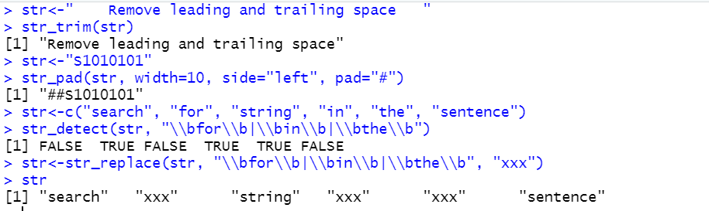
Data Conversion

Slide 38


